Slide 1
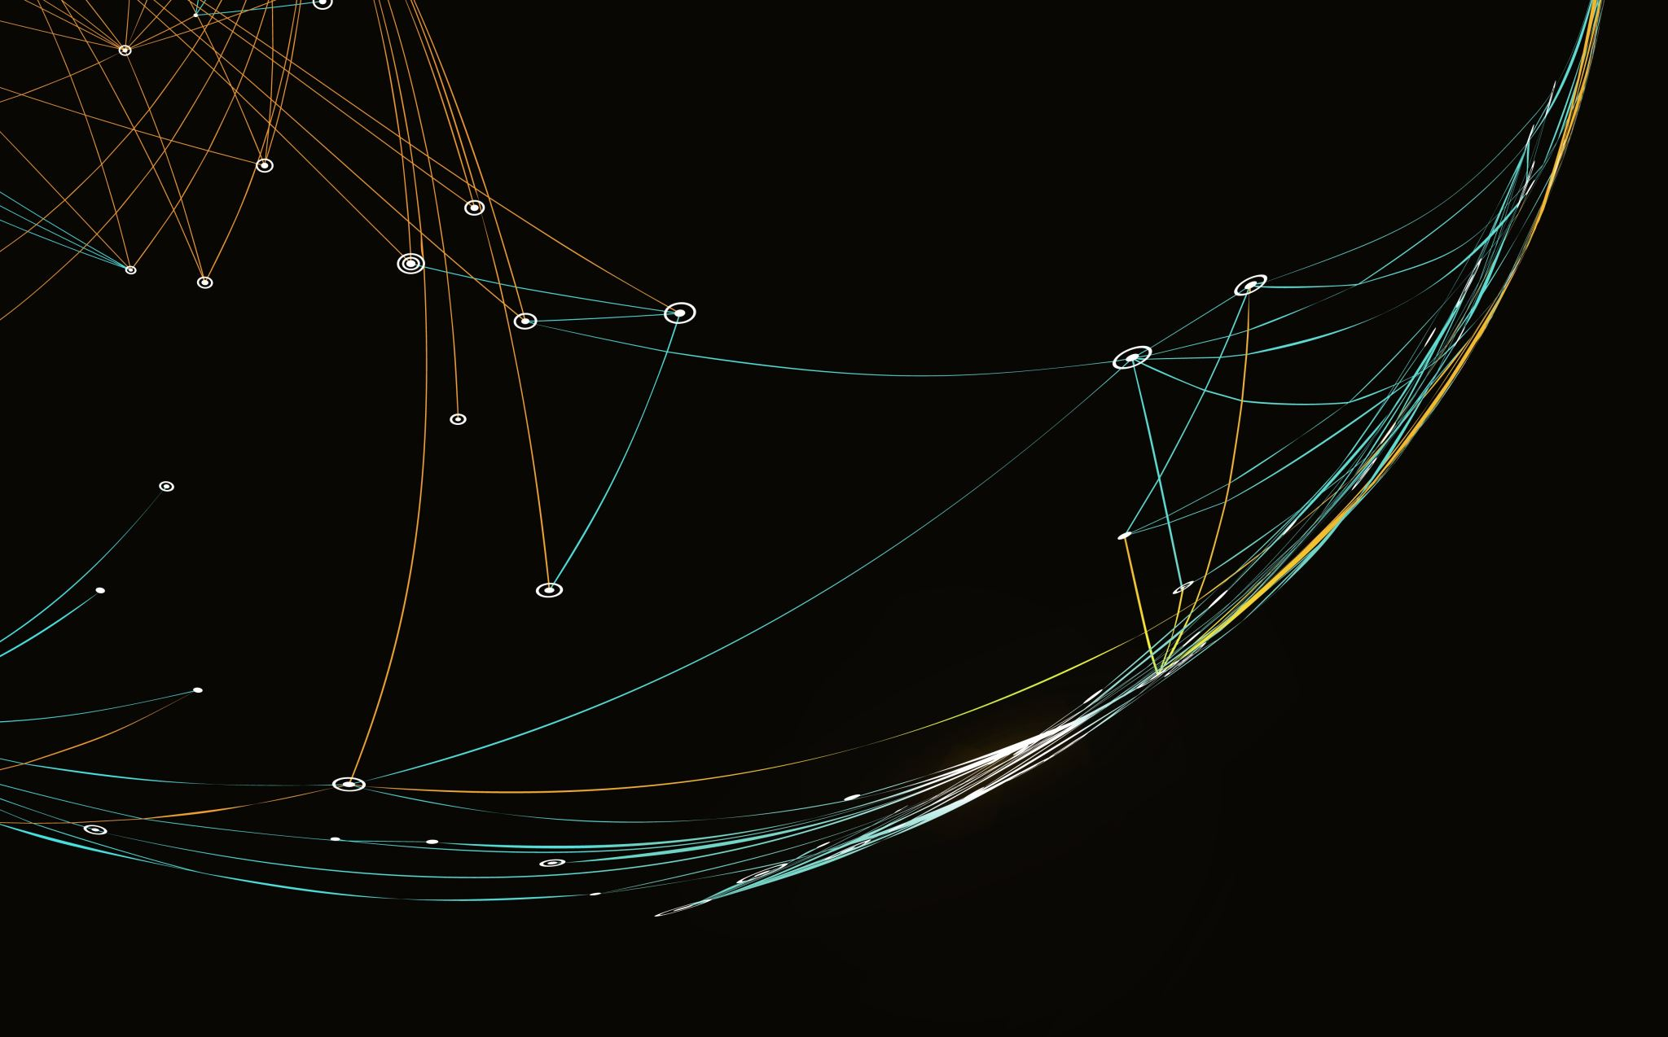
Build Your Website
Bernard’s Introduction to Build & Run a Website
Alysse’s Marketing Ideas
“Synergy between club members”
Bernard Wozny & Alysse Adularia
CWC Sacramento Network Meeting September 1st 2023

Slide 2
What you Will learn
What is a Website?
Why do I Need a Website?
What do I need on my Website?
How do I Market my Website?
N.B. using bernardwozny.com as examples.
Creating a Website is like creating a BOOK!

Slide 3
Why do I need Website?
A website is your main base on the Internet
Other Internet media may also be used
Self expression of who you are (an author)
Promote your Content (books etc.)
Links to Sales locations (Amazon, direct sales?!)
Blog and Email:
To push updates & information
To entertain your followers

Slide 4
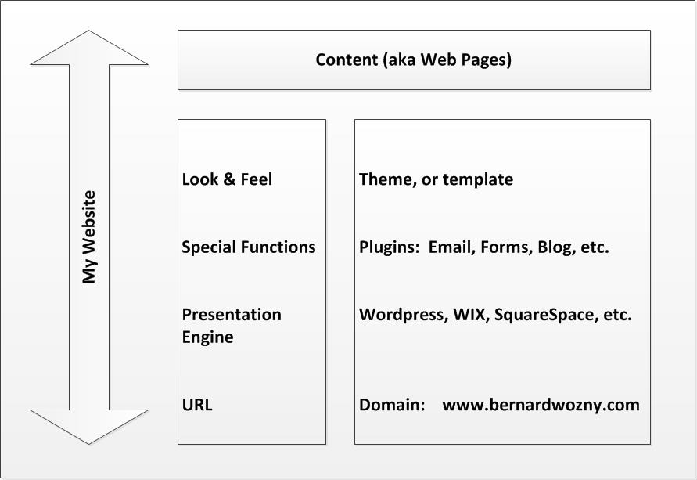
What is a Website?
A website is a hierarchy of functions – that carries the content you want to convey

Slide 5
My Domain
Purchase a domain ‘yourwebsite.com’ ($2?)
Purchase a Host Site (~$100 Per year)
Determine your presentation engine
WordPress, Wix, Squarespace, etc.

Slide 6
Domain Hosting
Sub Domain hosting – worth mentioning as a free option.
Example:
www.bernardwozny.wordpress.com
Simple features and functionality, a simple blog site.
Instead of
www.bernardwozny.com
Fully functional website
F
Make the website fit what you want to convey

Slide 7
Look & Feel
Presentation Engine: How to present your content?
Use a defined Theme
Manage images
Manage page displays
Single page
Columns
Menus
Headers (aka headlines)
F

Slide 8
Essential Functions
Things you MUST be able to do
Create Pages
Allow & manage Comments
Emails – Newsletter management
Blog – Entertain and stimulate
F
Make the website fit what you want to convey

Slide 9
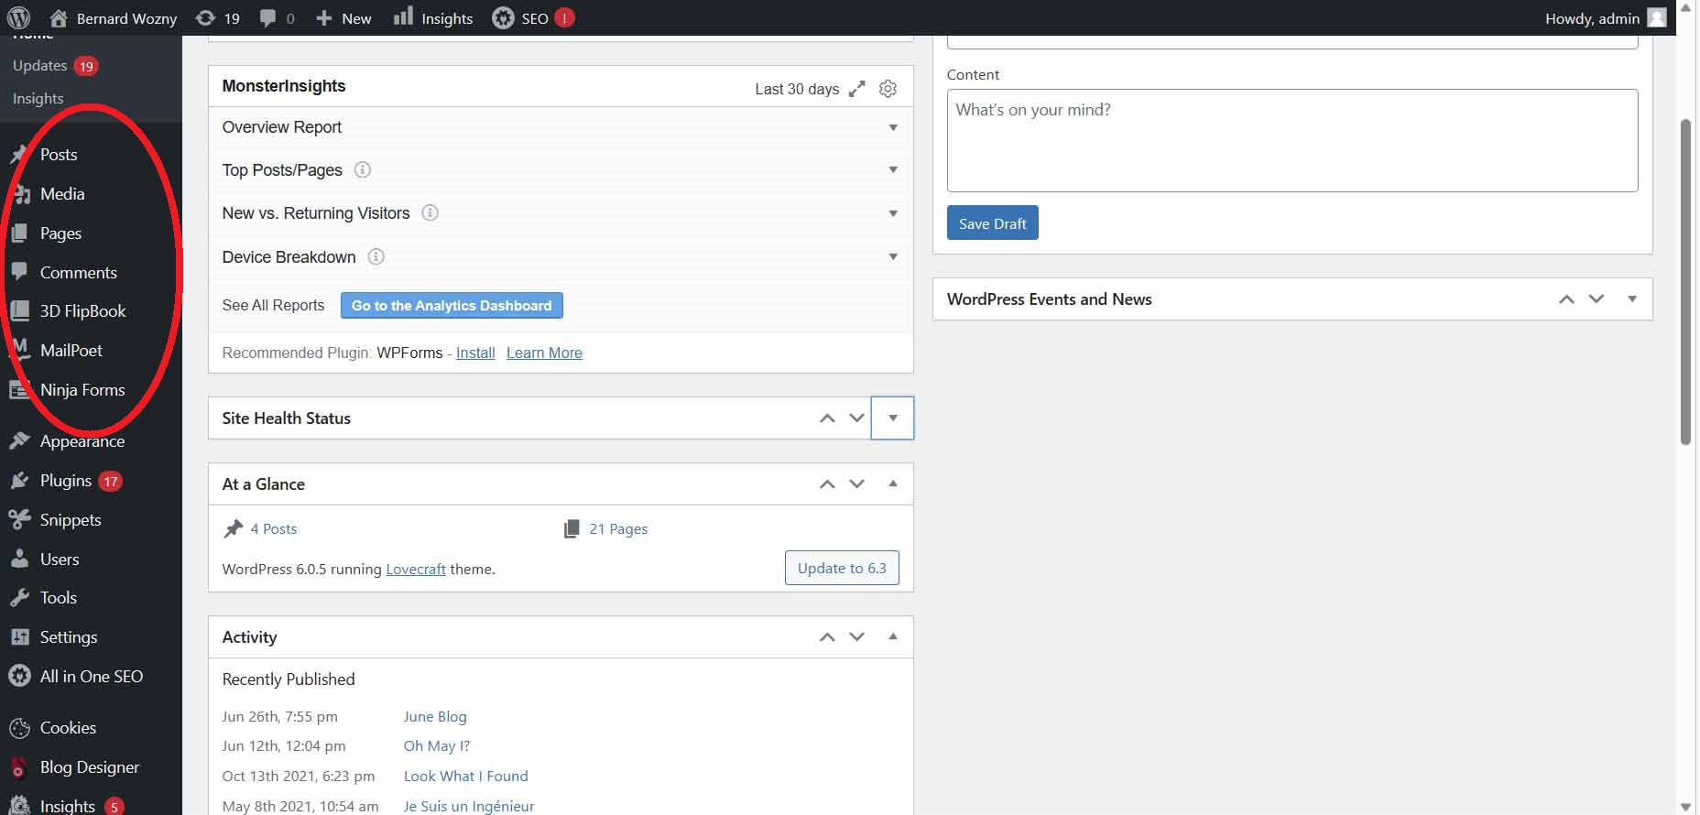
WordPress Dashboard
More to write here.

Slide 10
Emails & Newsletters 1
Best practice – use 2 step verification
Legality
Politeness
How to attract emails?
Subject for next presentation
You must be proactive online
Must have Unsubscribe option

Slide 11
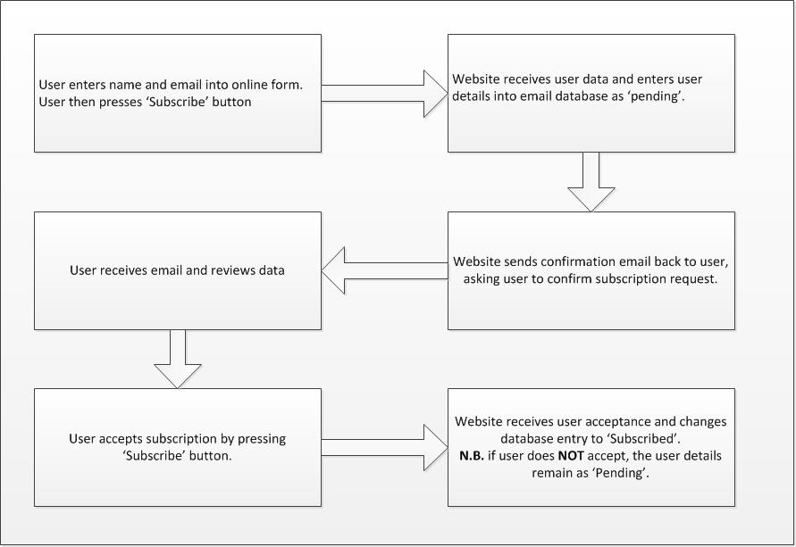
Emails & Newsletters 2
How to handle the First Email
Make the website fit what you want to convey

Slide 12
Content
All the pages, words, images, or anything else you want to portray
You must have;
Home Page – this is the landing page of the URL
About Me – this can be the above page
My Books – a list of all books, including synopsis, links to purchase locations etc.
Contact me
You Really Need to have;
Blog – may use a plugin
Email – requires a plugin
Subscribe to Newsletter – a secondary landing page

Slide 13
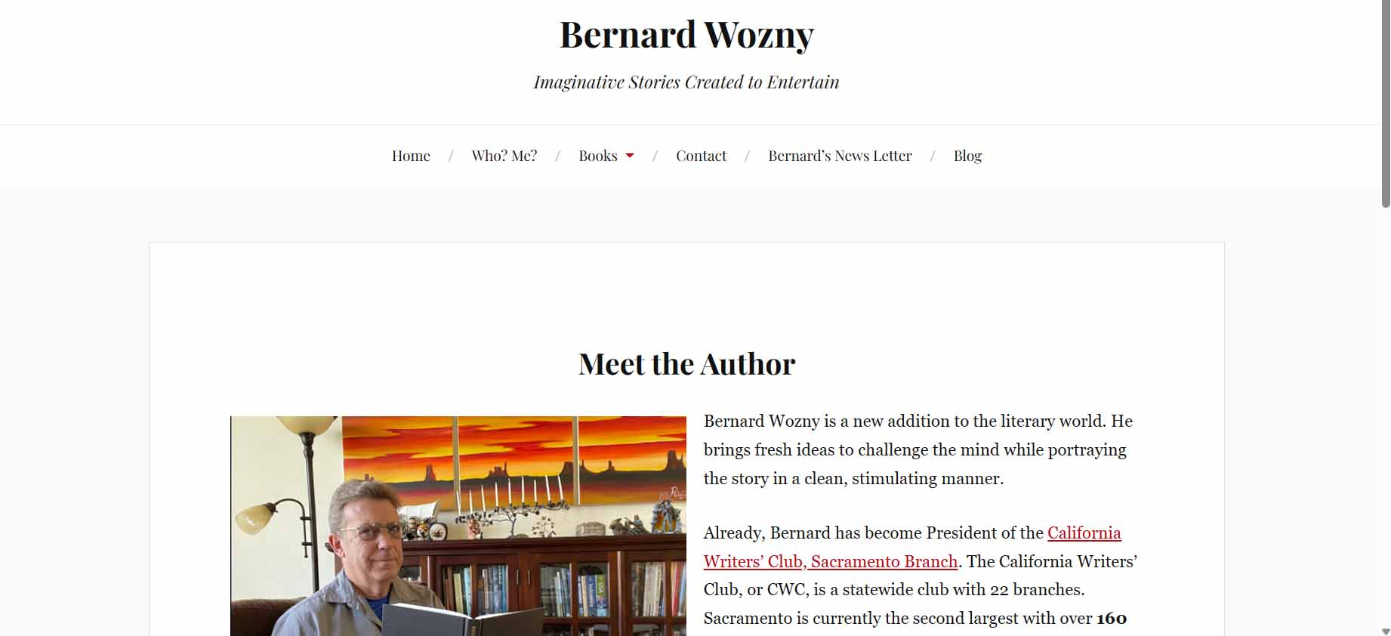
Home Page 1

Slide 14
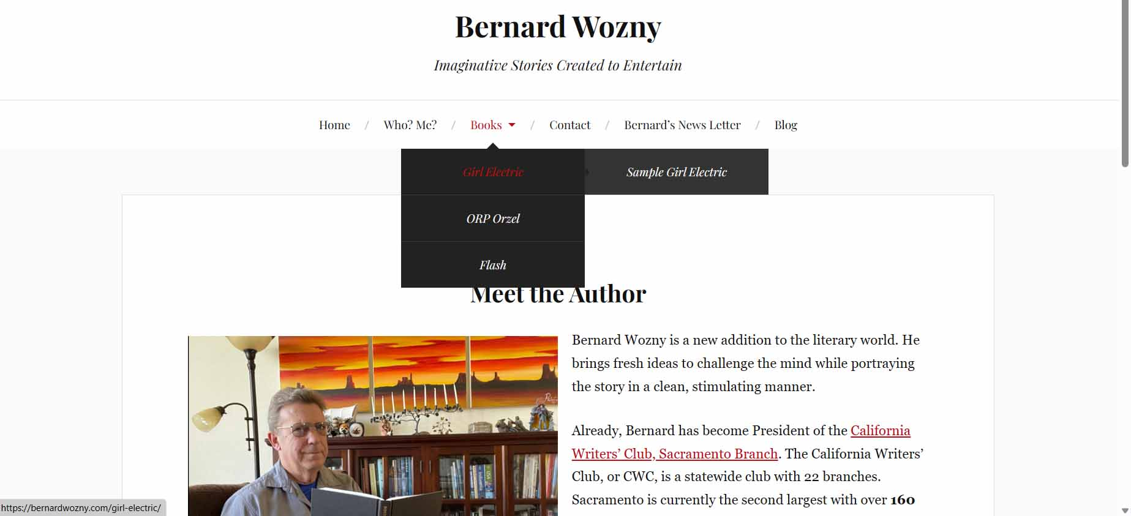
Home Page 2

Slide 15
Hosting Options
Shop around for the hosting package
Godaddy
Bluehost
Ionos
Dreamhost
Many others
Compare price, support, speed, tools, presentation engine, SSL, domain.

Slide 16
Presentation Engine Options
Decide on the Features you want
WordPress
Wix
Ionos
Shopify
Squarespace
Compare tools, themes (aka templates), migratability, ease of use, eCommerce.

Slide 17
Note on WordPress
WordPress is Bernard’s weapon of choice
Feature rich – a plugin for everything!
Simple sites can easily be built
Easy to expand
Can migrate (to any WordPress compatible host site)
Warning! Can be technically intimidating to set up
www.wordpress.com – for your simple blog site.
www.wordpress.org – to download WP components.
Free support (note use of forums)

Slide 18
What I Haven’t Covered
SEO – Search Engine Optimization
Google Analytics
Tools:
Backups
Traffic analysis
Site Maintenance
Loads of other stuff

Slide 19
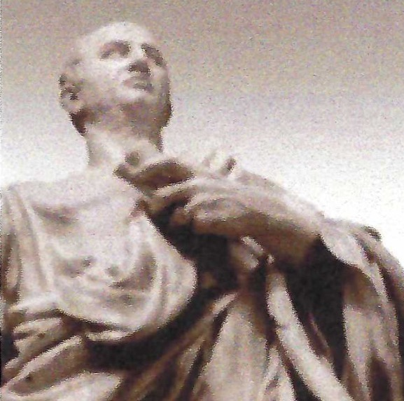
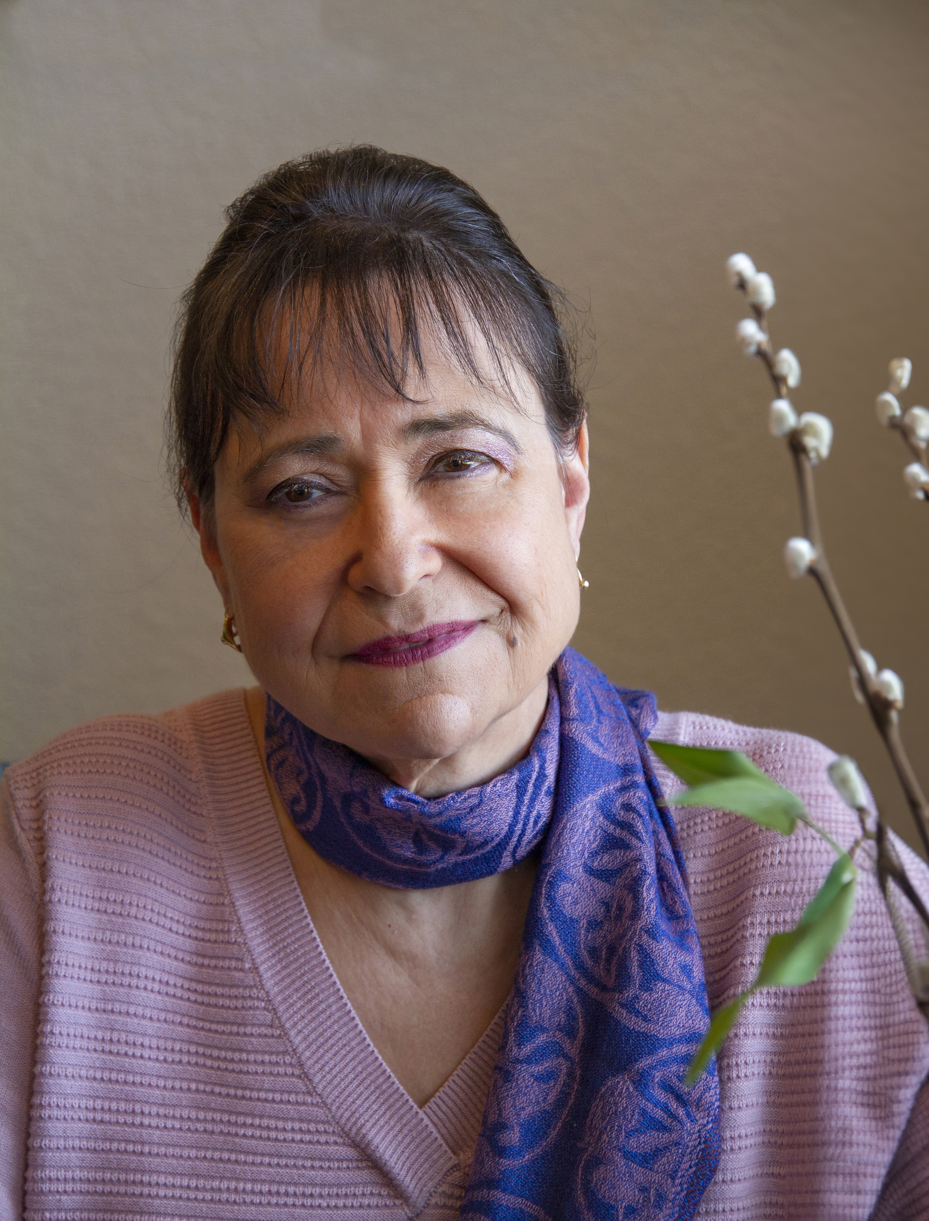
Marketing 101a
Alysse Adularia
Writer, Rhetorician

Slide 20
Leave a message

Slide 21
REFOCUS YOUR CREATIVITY
You’re in business now
Be the decision maker

Slide 22
Aristotle Said it Best
There’s nothing new about marketing
Everything is an argument
Some of it is obvious
Hopefully, you’ve been doing some of the work as you write

Slide 23
Know who you’re writing for
Genre (it doesn’t stop there)
For example, are they women? men?
How much do they read?
What is their diction level?
What is their ethnicity?
What is their socio-economic standing
Where and how did they grow up?
What do they do in their spare time?
Something else?

Slide 24
What do you want your reader to do when they’ve finished reading?
Recommend it?
Read it to someone?
Read it again?
See the world differently, change their attitude?
Change something in their life?
Become motivated?
Learn something?
Have more hope?
Change how they think?
Buy the next installment?

Slide 25
Create Your Argument
Ethos: do it because of who I am
Logos: do it because it makes sense
Pathos: do it because of how it makes you feel
Often there will be more than one is needed

Slide 26
Apply your argument to EVERYTHING
Website, design, and content
Bio
Title and cover art
Cover jacket, introduction, summary
Press release
Query
Two sentence pitch
Blog
Personal appearances

Slide 27
Question Time
Bernard Wozny, bpwozny@gmail.com
www.bernardwozny.com

