Slide 1
Freelance Writing Fundamentals
How To Pitch Your Story Ideas to Editors

Slide 2
Why Should Your Story Be Featured in the Media?
You have unique perspectives, experiences, and life stories that can make an impact.
Readers crave more real-person stories these days. They want relatability, inspiration, and insights that can help them improve their own lives.
People trust (most!) media sites, so it boosts your credibility when you’re featured on them.
People appreciate it when you’re vulnerable enough to share your challenges, frustrations, and setbacks.

Slide 3
How To Determine Your Story Idea
1. Ask yourself, “What challenges have I gone through? And what lessons have I learned?” (i.e., career, health, relationship issues)
2. “Where does my expertise lie? What do I enjoy writing about?” (i.e., travel, cooking, finance)
3. “What is nobody talking about within this niche or topic?” (i.e., platonic breakups)

Slide 4
My Seven-Step Formula for the Perfect Pitch

Slide 5
Step 1: Familiarize Yourself With the Publication
Read a few stories each day to get a feel for the tone, target audience, and topics covered.
Conduct a search with main key words to make sure a story like yours hasn’t been published before (i.e., “book marketing tips”).

Slide 6
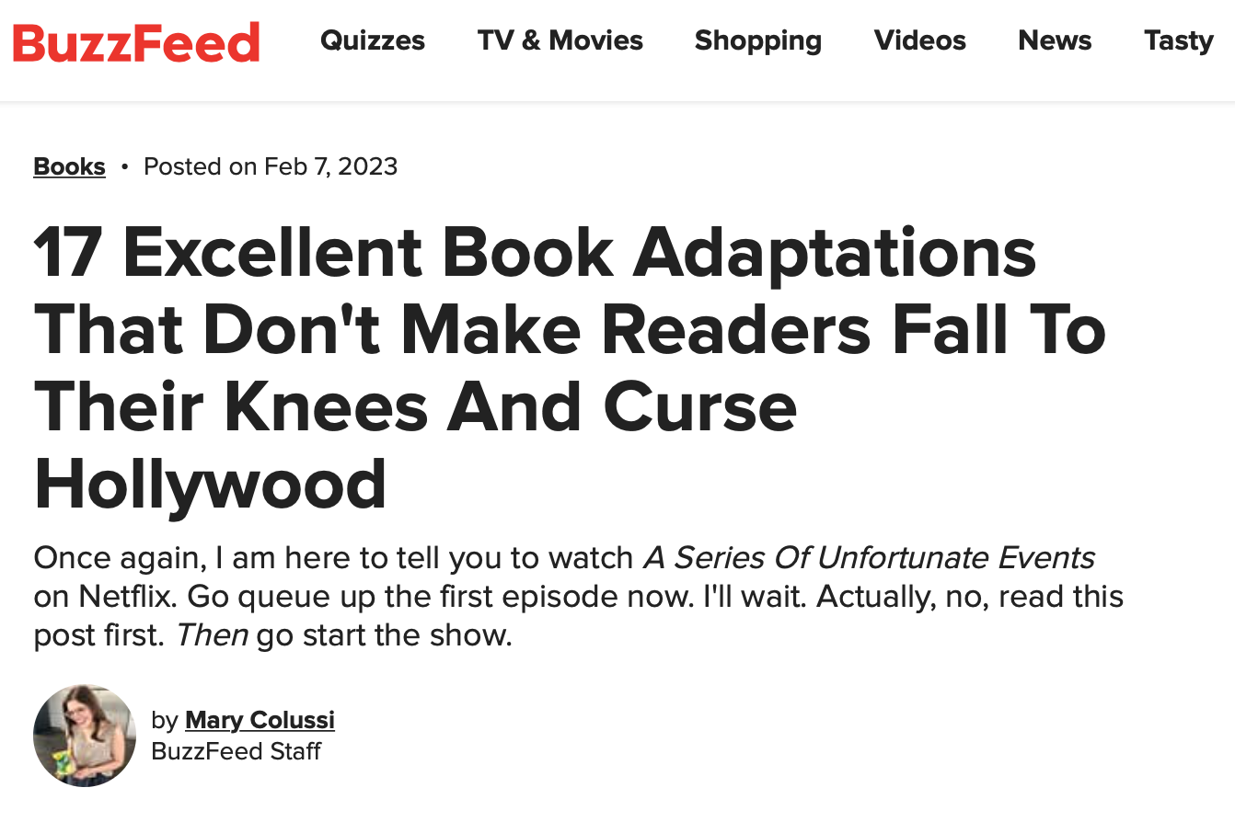
Step 2: Start With a Catchy Headline
Include it in the subject line as “PITCH: [Your Proposed Headline]”
Make it bold, funny, or sassy.

Slide 7
Step 3: Use a Compelling Opening Statement
Introduce yourself in 1-2 sentences, then DIVE right into the story idea.
Start with an interesting fact, quote, question or anecdote.
You want the editor to keep reading!

Slide 8
Step 4: Answer the Two Big “Why”s
Why should the publication cover the story now?
-Is it tied to current events? A certain heritage/awareness month?
Why are you the one to tell this story? (includes expertise/experiences)
-What new perspectives or ideas are you adding to the existing conversation?

Slide 9
Step 5: Keep It Brief
Aim for about 300 words.
Focus on key points!
Include sources you plan to interview, if applicable.

Slide 10
Step 6: Include Writing Samples
Include links to relevant writing samples and/or your portfolio.

Slide 11
Step 7: Follow Up After Two Weeks
Editors are BUSY people!
Follow up ONCE if you haven’t heard back after two weeks.
Use a spreadsheet to keep track of all your pitches.

Slide 12
Practical Tips
Don’t pitch two editors from the same publication.
Don’t send the same version of a pitch to several editors. Personalize each pitch as much as possible.
Always follow up!
Leave links to your social media channels and website.

Slide 13
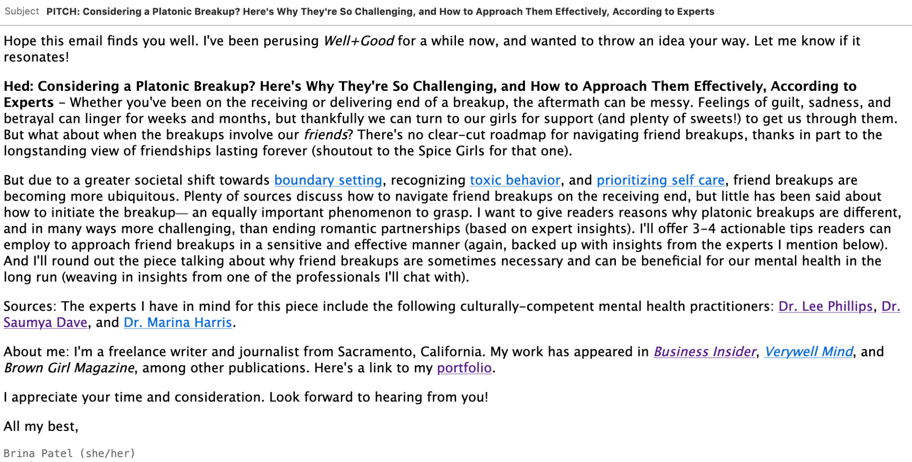

Slide 14
A Few Publications That Accept Pitches From Freelance Writers
Fodor’s Travel
Atlas Obscura
Good Housekeeping
SELF
Travel + Leisure
Business Insider
Well+Good
Women’s Health
Oprah Daily
Vox
HuffPost

Slide 15
Useful Resources
Selena Soo’s Publicity Calendar
Sonia Weiser’s Opportunity of the Week Newsletter
42 Publications That Pay Freelance Writers in 2023 (my website)
The Freelance Writing Roadmap

Slide 16
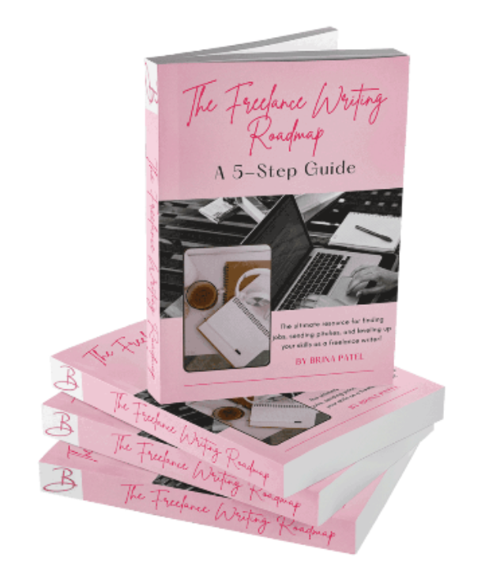

Slide 17
What Can You Expect?
How to create a portfolio with ZERO experience so you can make a good first impression with new clients
The BEST places to find writing jobs
A list of outlets that PAY writers to save you the guesswork of where to send your ideas
Tips for pitching editors + an email template that’ll help you hone in on your story ideas
An actual pitch that helped me land a story in Business Insider that you can reference when you’re putting together your own pitches

Slide 18
THANK YOU & HAPPY PITCHING! :)

