Slide 1
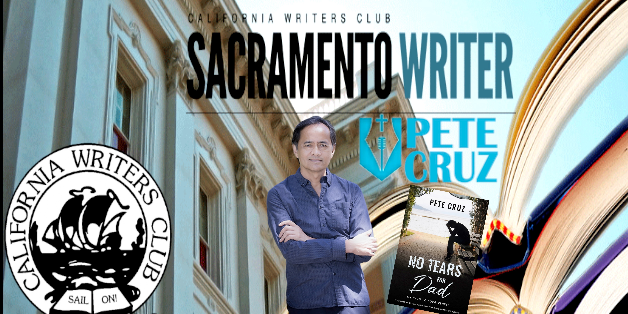

Slide 2
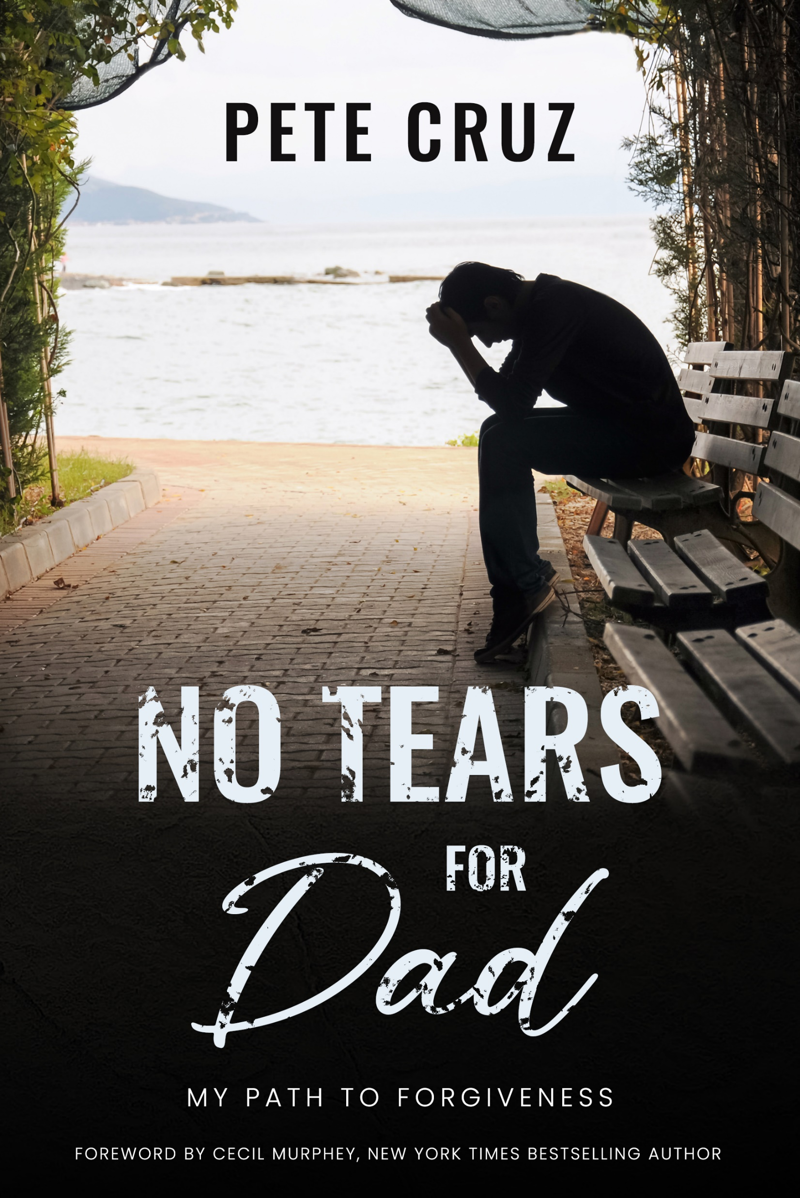
Notes:
This slide is for Zoom viewers
I will refer to Banner

Slide 3
“People don’t turn to stories to experience what you, the writer, have experienced—or even what your characters have. They read to have their own experience.”—David Corbett
Notes:
Readers relate to emotions, engage, go on the journey
Click to transition Corbett quote

Slide 4
“If you do your job as a writer, the book doesn’t belong so much to you anymore; it belongs to those impacted by it. So having said that, I definitely feel like ‘Wild’ isn’t mine anymore. It belongs to the readers.”—Cheryl Strayed
Notes:
Read Wild example first, then Mimi
Book dedication.
Almost 10 years ago, Mimi.

Slide 5
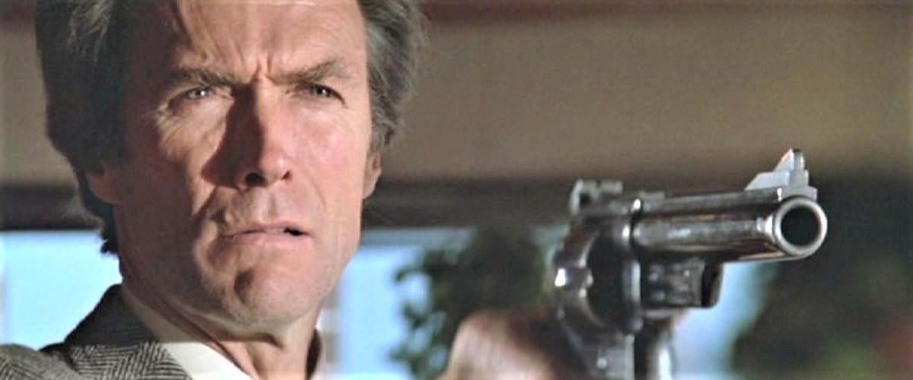
Go ahead.
Make my day!
Notes:
Guys, the Old School, are conditioned or permitted not to express emotions
Then click for quote

Slide 6
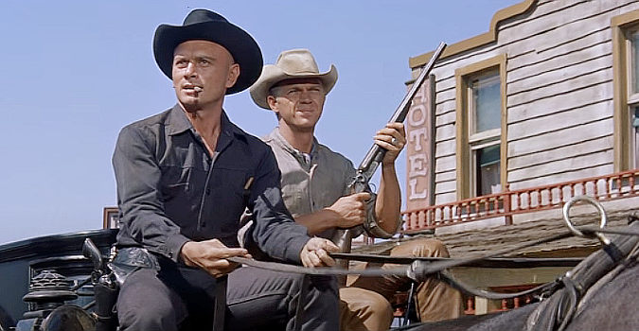
Solving problems isn’t our line. We deal in lead, friend.
Notes:
Click for quote
Ignore feelings
Pull up your bootstraps
Be tough, Man up
It’s hard enough to feel our emotions, let alone write about them

Slide 7
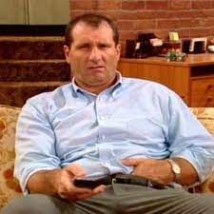
Telling Al Bundy is just like telling the wind.
Notes:
Click for quote

Slide 8
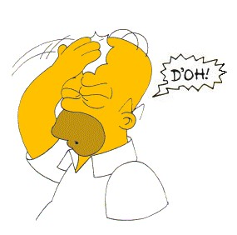
D’OH!
Notes:
The male role model changed
Click for D’OH!

Slide 9
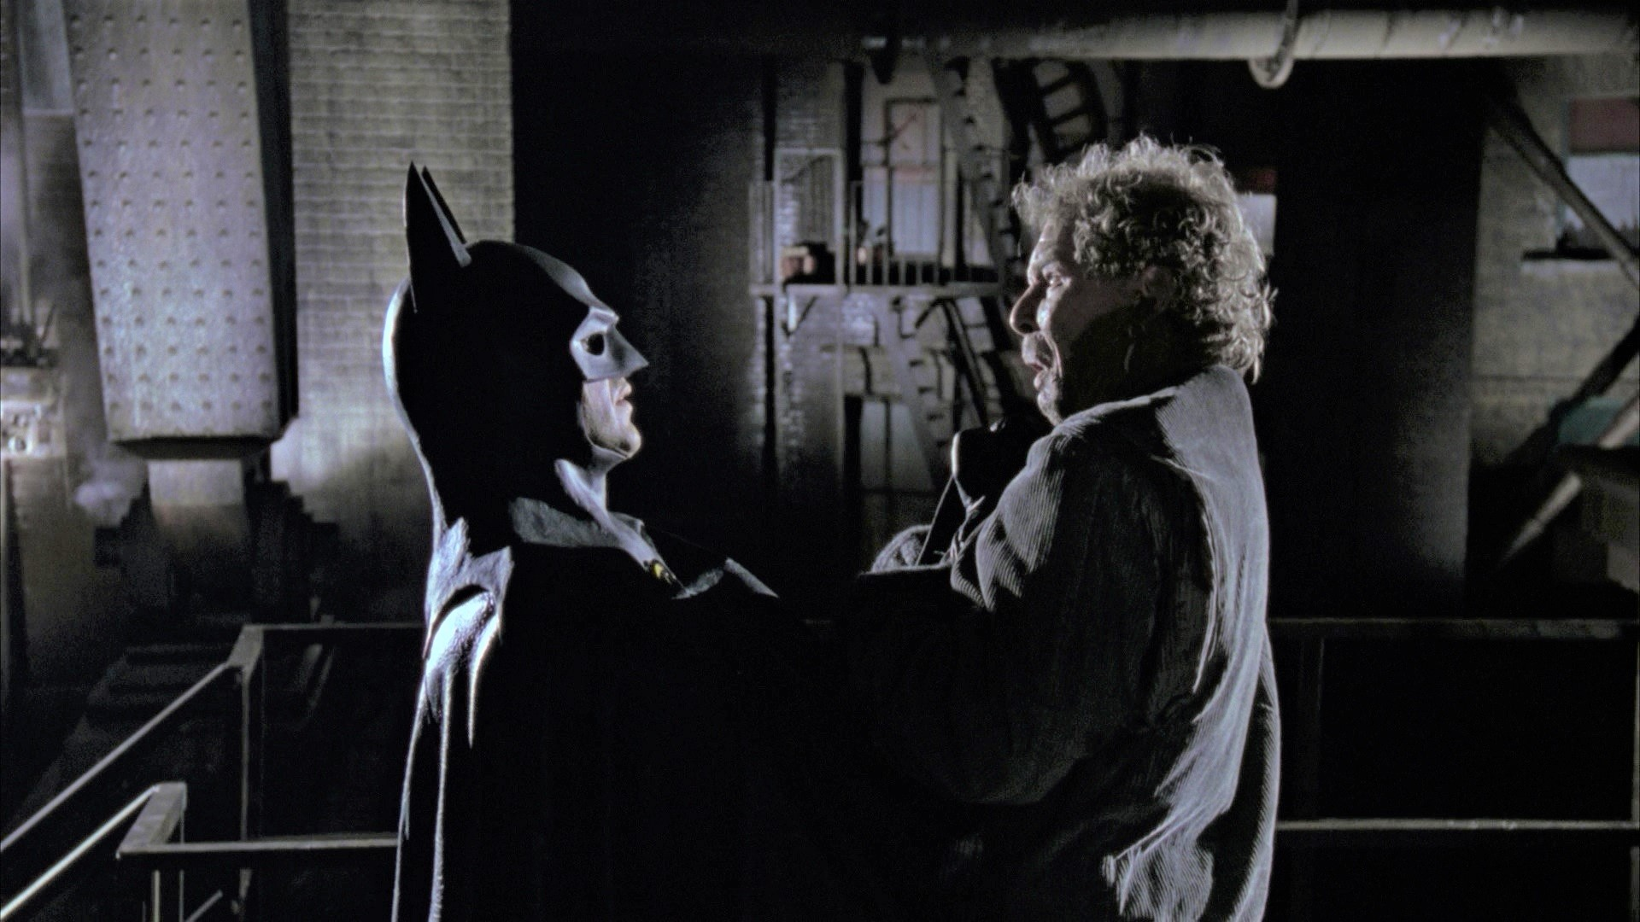
I’m BATMAN!

Slide 10
I wonder, woman

Slide 11
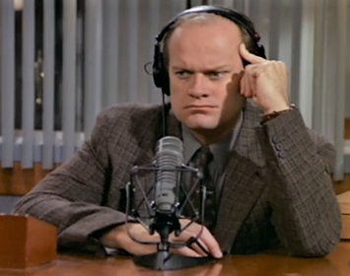
How does that make you feel?

Slide 12
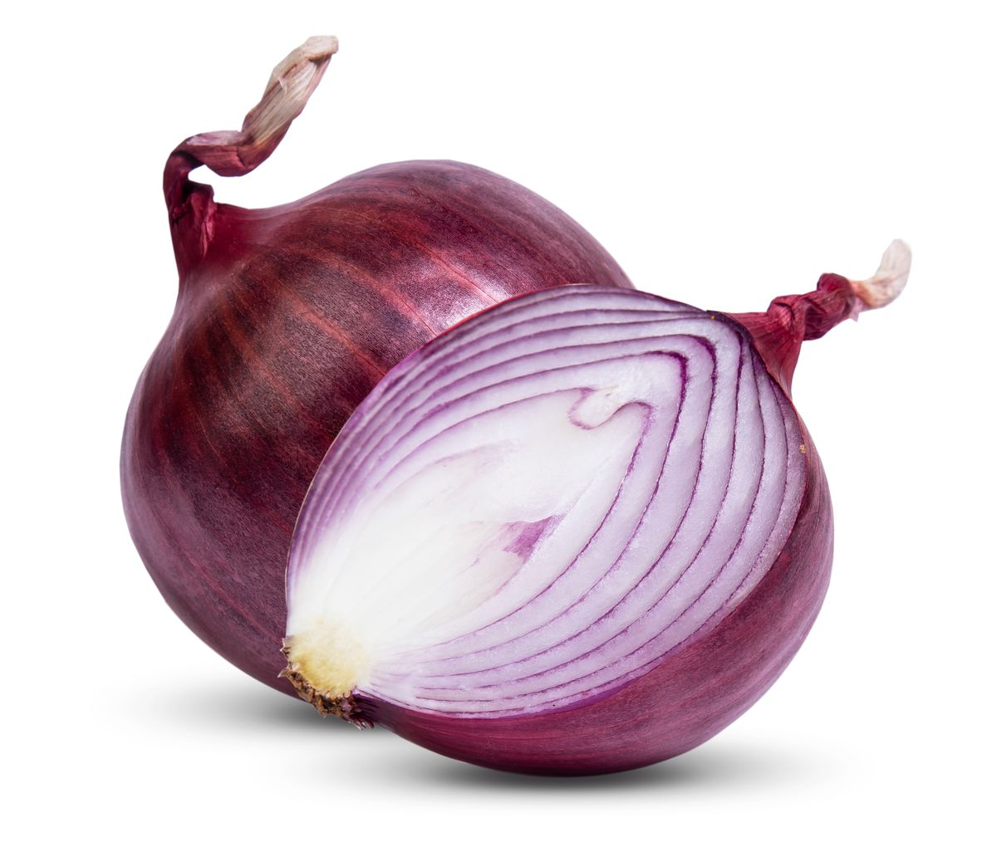
Notes:
Peel back enough layers and you’ll cry

Slide 13
Notes:
Counselor: “How would you rate it?”

Slide 14
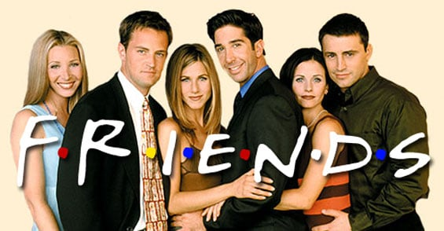
Notes:
Joey: “How you doin’?

Slide 15
SHOW, NOT TELL
Notes:
My book got published! (Ecstatic)

Slide 16
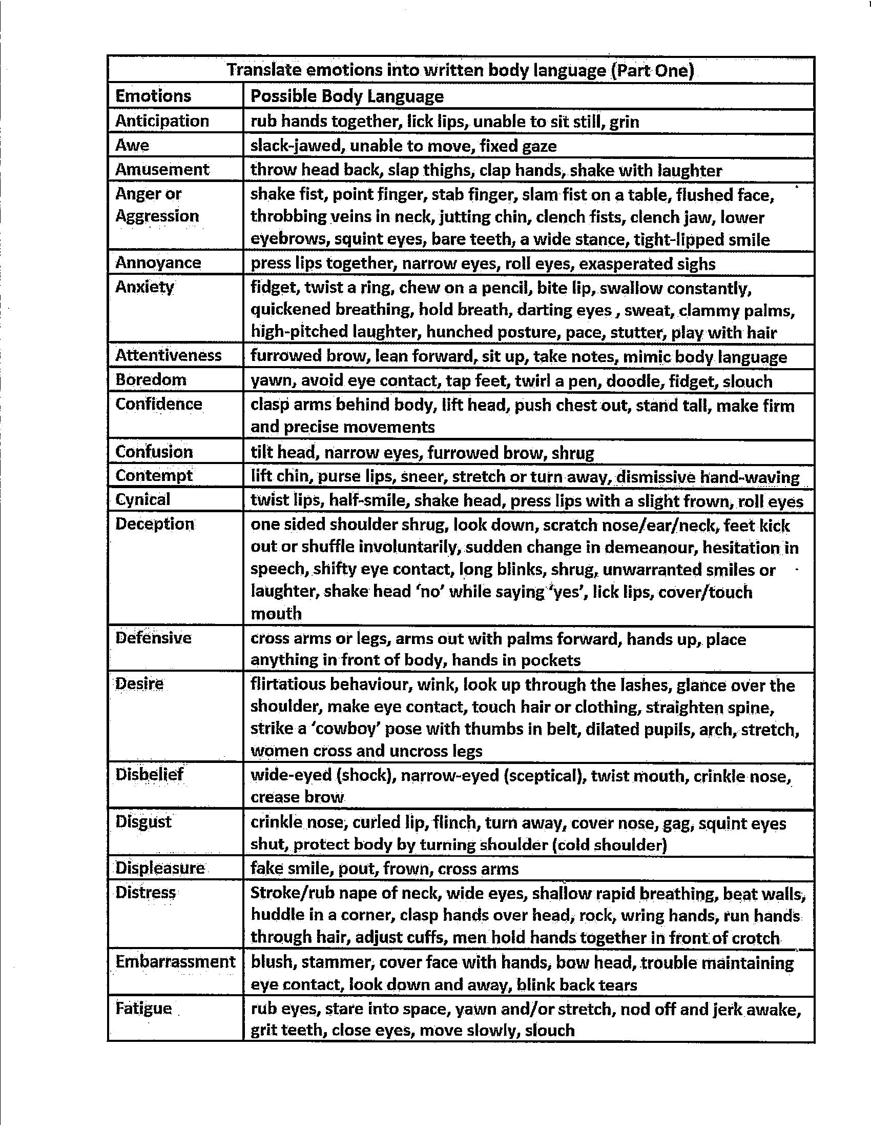
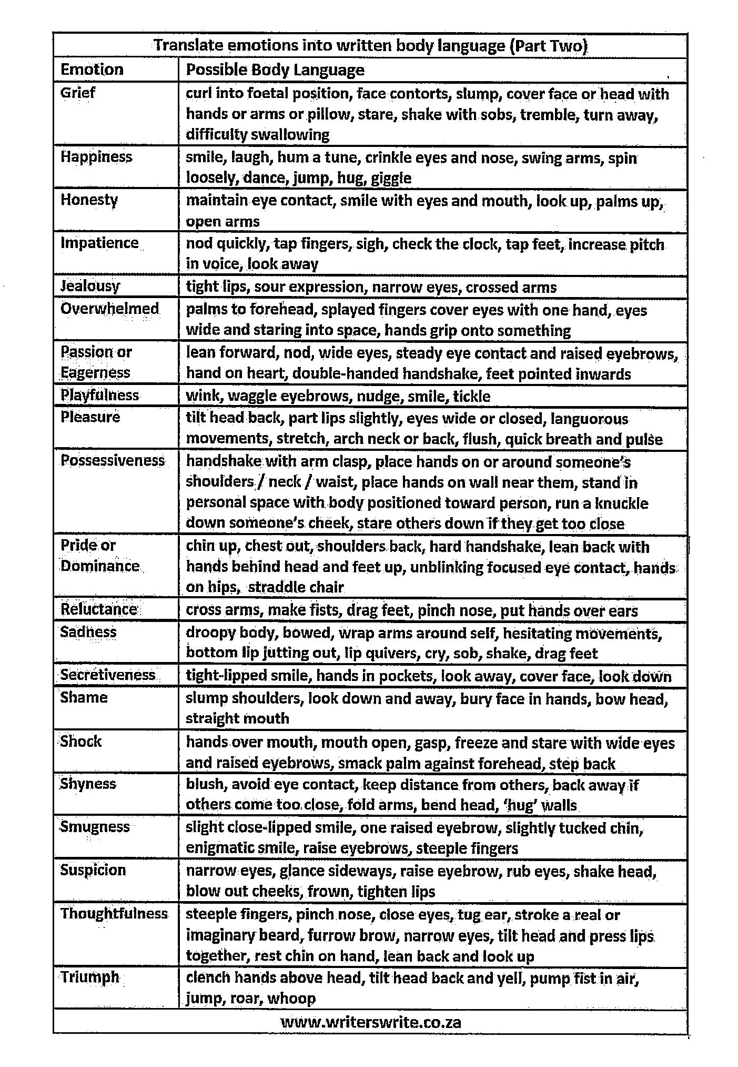

Slide 18
Anxiety
Nervous
Scared
Shock
Disbelief
Overwhelmed
“She looked as if she were seated in a movie theater watching a horror movie, and I was the villain.
“The pupils of her eyes widened while her lips pressed into a single horizontal line
”She slumped and seemed to have stopped breathing. She was bracing herself”
Resignation
Stunned
Numb
“Fling the plastic top across the room like a misshapen Frisbee? Or dunk it into the trash bin like a basketball while yelling choice expletives?”
Outrage
Disgust
Incensed

Slide 19
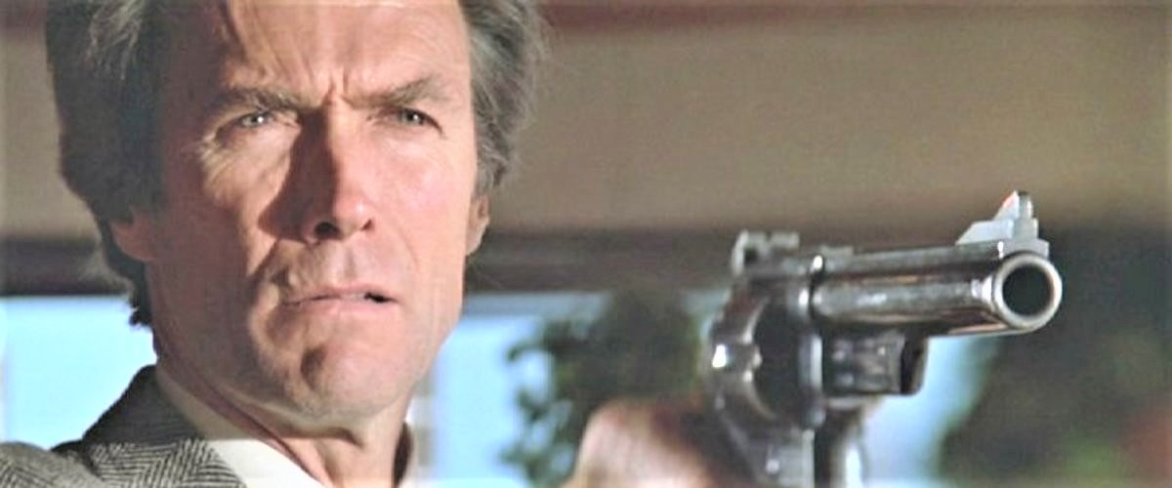
“Images of what my own angered expression must have looked like filled my mind. I’d have slits for eyes, my jaw jutting and hardened, and my forehead creased with blood vessels.
I retreated to the hallway and leaned against the wall to consider my response. Memories of Dad rushing to his room to retrieve one of his belts loomed fresh in my mind. I wished for my daughter to avoid the same terror of impending doom I experienced.
Remorse
Shame
Compassion

Slide 20
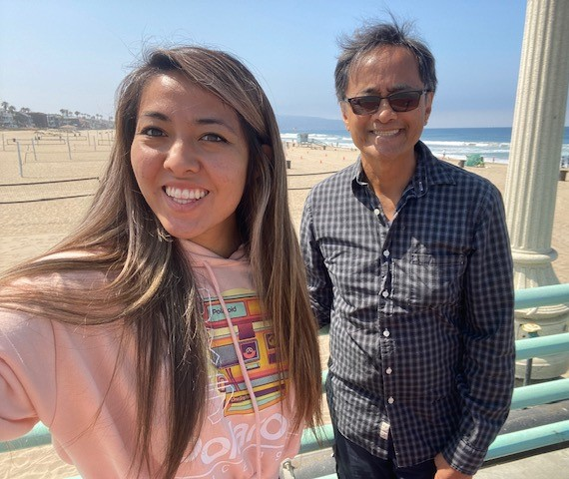
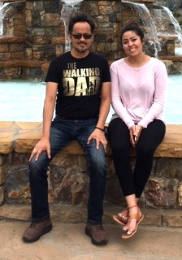

Slide 21
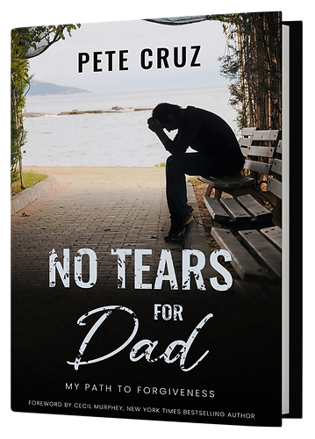
CWC 1ST FRIDAY Attendees
Signed copy
$20.00
Order from:
www.PeteCruz.com
Amazon
Barnes & Noble
Redemption Press

